Slide 1
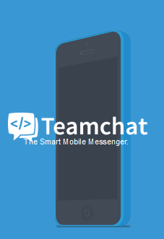

Slide 2

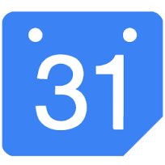
Google Calendar Teamchat integration
Google calendar & Teamchat integration would help users to view events directly through Teamchat.
The users will also get a notification for the next scheduled event right before time set by the user.

Slide 3
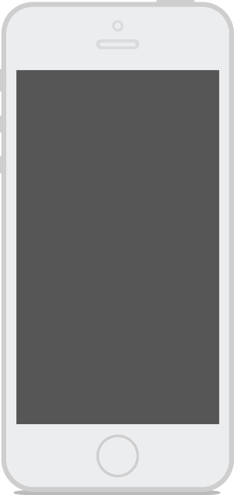
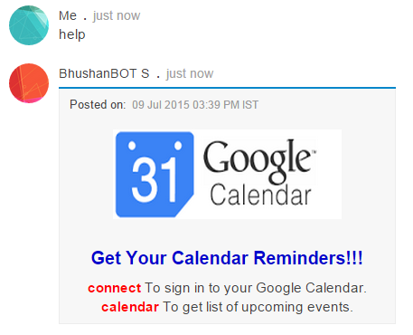
Work-Flow
Help keyword is used
to activate the bot

Slide 4
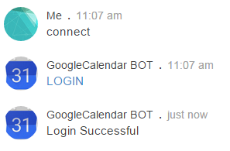
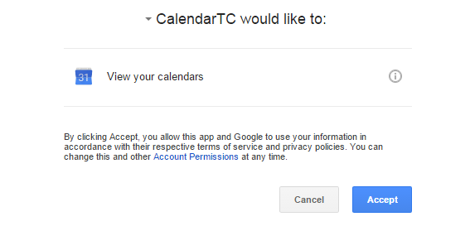

Slide 5
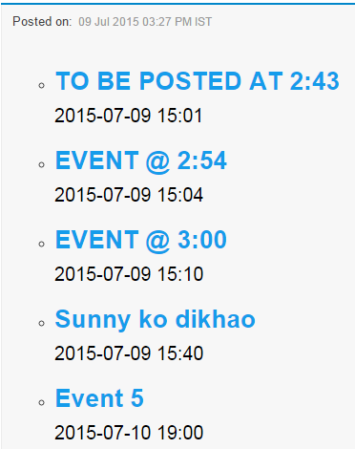
Keyword calendar posts all the
Events made in the calendar

Slide 6
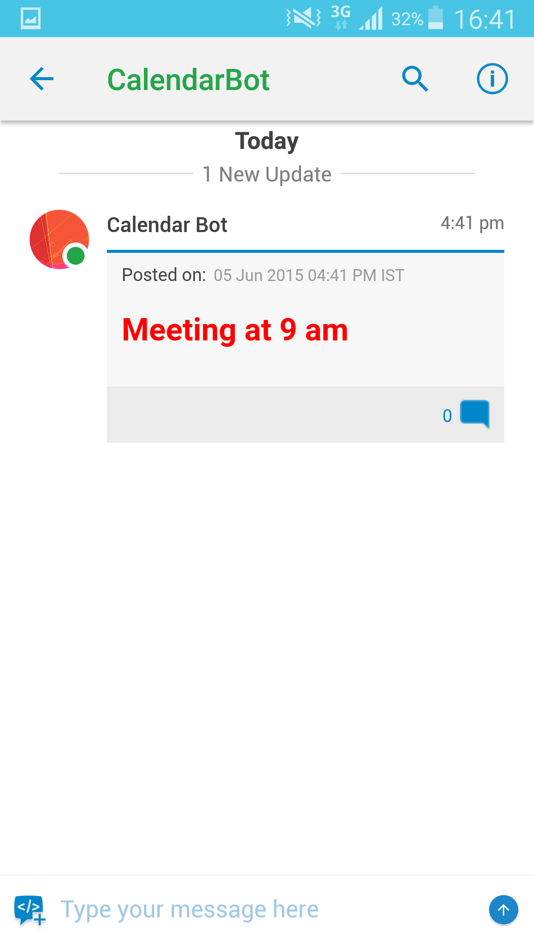
Alarm notification
There is a chatlet
created reminding
about the event to be
held at the set
date and time

Slide 7
